Slide 1

Sports Data Analytics Platform
21107004: Sumit Shahu
21107057: Pravesh Yadav
21107020: Ankit Purohit
21107065: Mustafa Shaikh
Project Guide
Prof. Poonam Pangarkar

Slide 2
Contents
Introduction
Objectives
Scope
Features
Project Outcomes
Technology Stack

Slide 3
1. Introduction
Sports data analytics is a python based application , which
helps users to better understand various sports and factors
related to olympics.
Problems Identified:
It was difficult for the users to get various details regarding
past years sports data and other Olympic related data on a
single platform.
Solution Proposed:
Sports data analytics makes it easy for users to access any Olympic related data on a single platform.

Slide 4
2. Objectives
To identify patterns and trends by analysing data of past events.
To evaluate performance.
To make inform decisions.
To create visualization.
To compare data in various forms.
for eg: graphs, charts , maps , etc.
To predict outcomes.

Slide 5
3. Scope
Can be useful for users who are less aware about the events
taking place in Olympics.
Can be useful to inspire ordinary people to set and achieve their
own fitness goals
Can be applied to increase participation.
Can be useful for inspiring career paths.
Can help in understanding the impact of various factors on
performance of athletes.
Can be useful to predict winners to a certain extent.

Slide 6
4. Features
Feature 1 :
All Data Related to Olympics can be displayed on a single
platform
Feature 2 :
User Can Modify the overall data according to their needs
Feature 3 :
By analyzing the trends in the last few years one can predict the outcomes of the Game

Slide 7
5. Outcome of Project
User can create an account and hence can login whenever
required.
2. User can have access to past data of the events which took place
in a particular year.
User can analyse events as per :
Overall analysis
Country wise analysis
Athlete wise analysis
4. Admin can manage and update data whenever required.

Slide 8
6. Technology Stack
Front end (GUI)
Python 3.11.1
Streamlit 1.15.0
Backend (Database)
Mysql 8.0

Slide 9
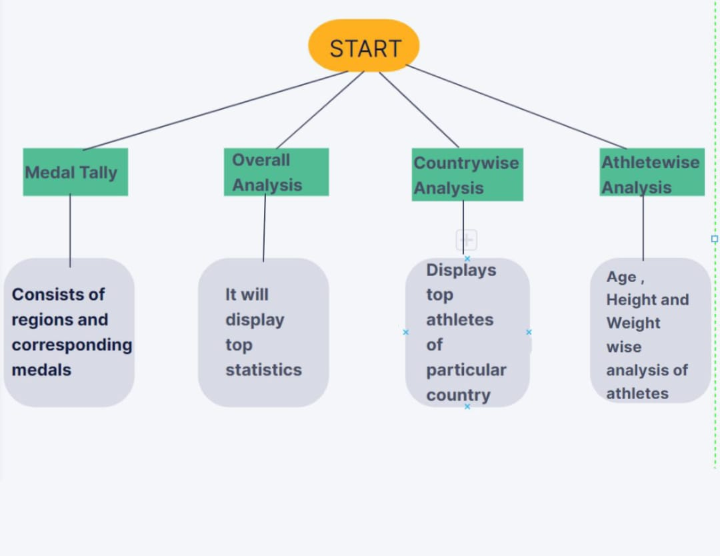
7. Block Diagram

Slide 10
Thank You...!!

